Slide 1

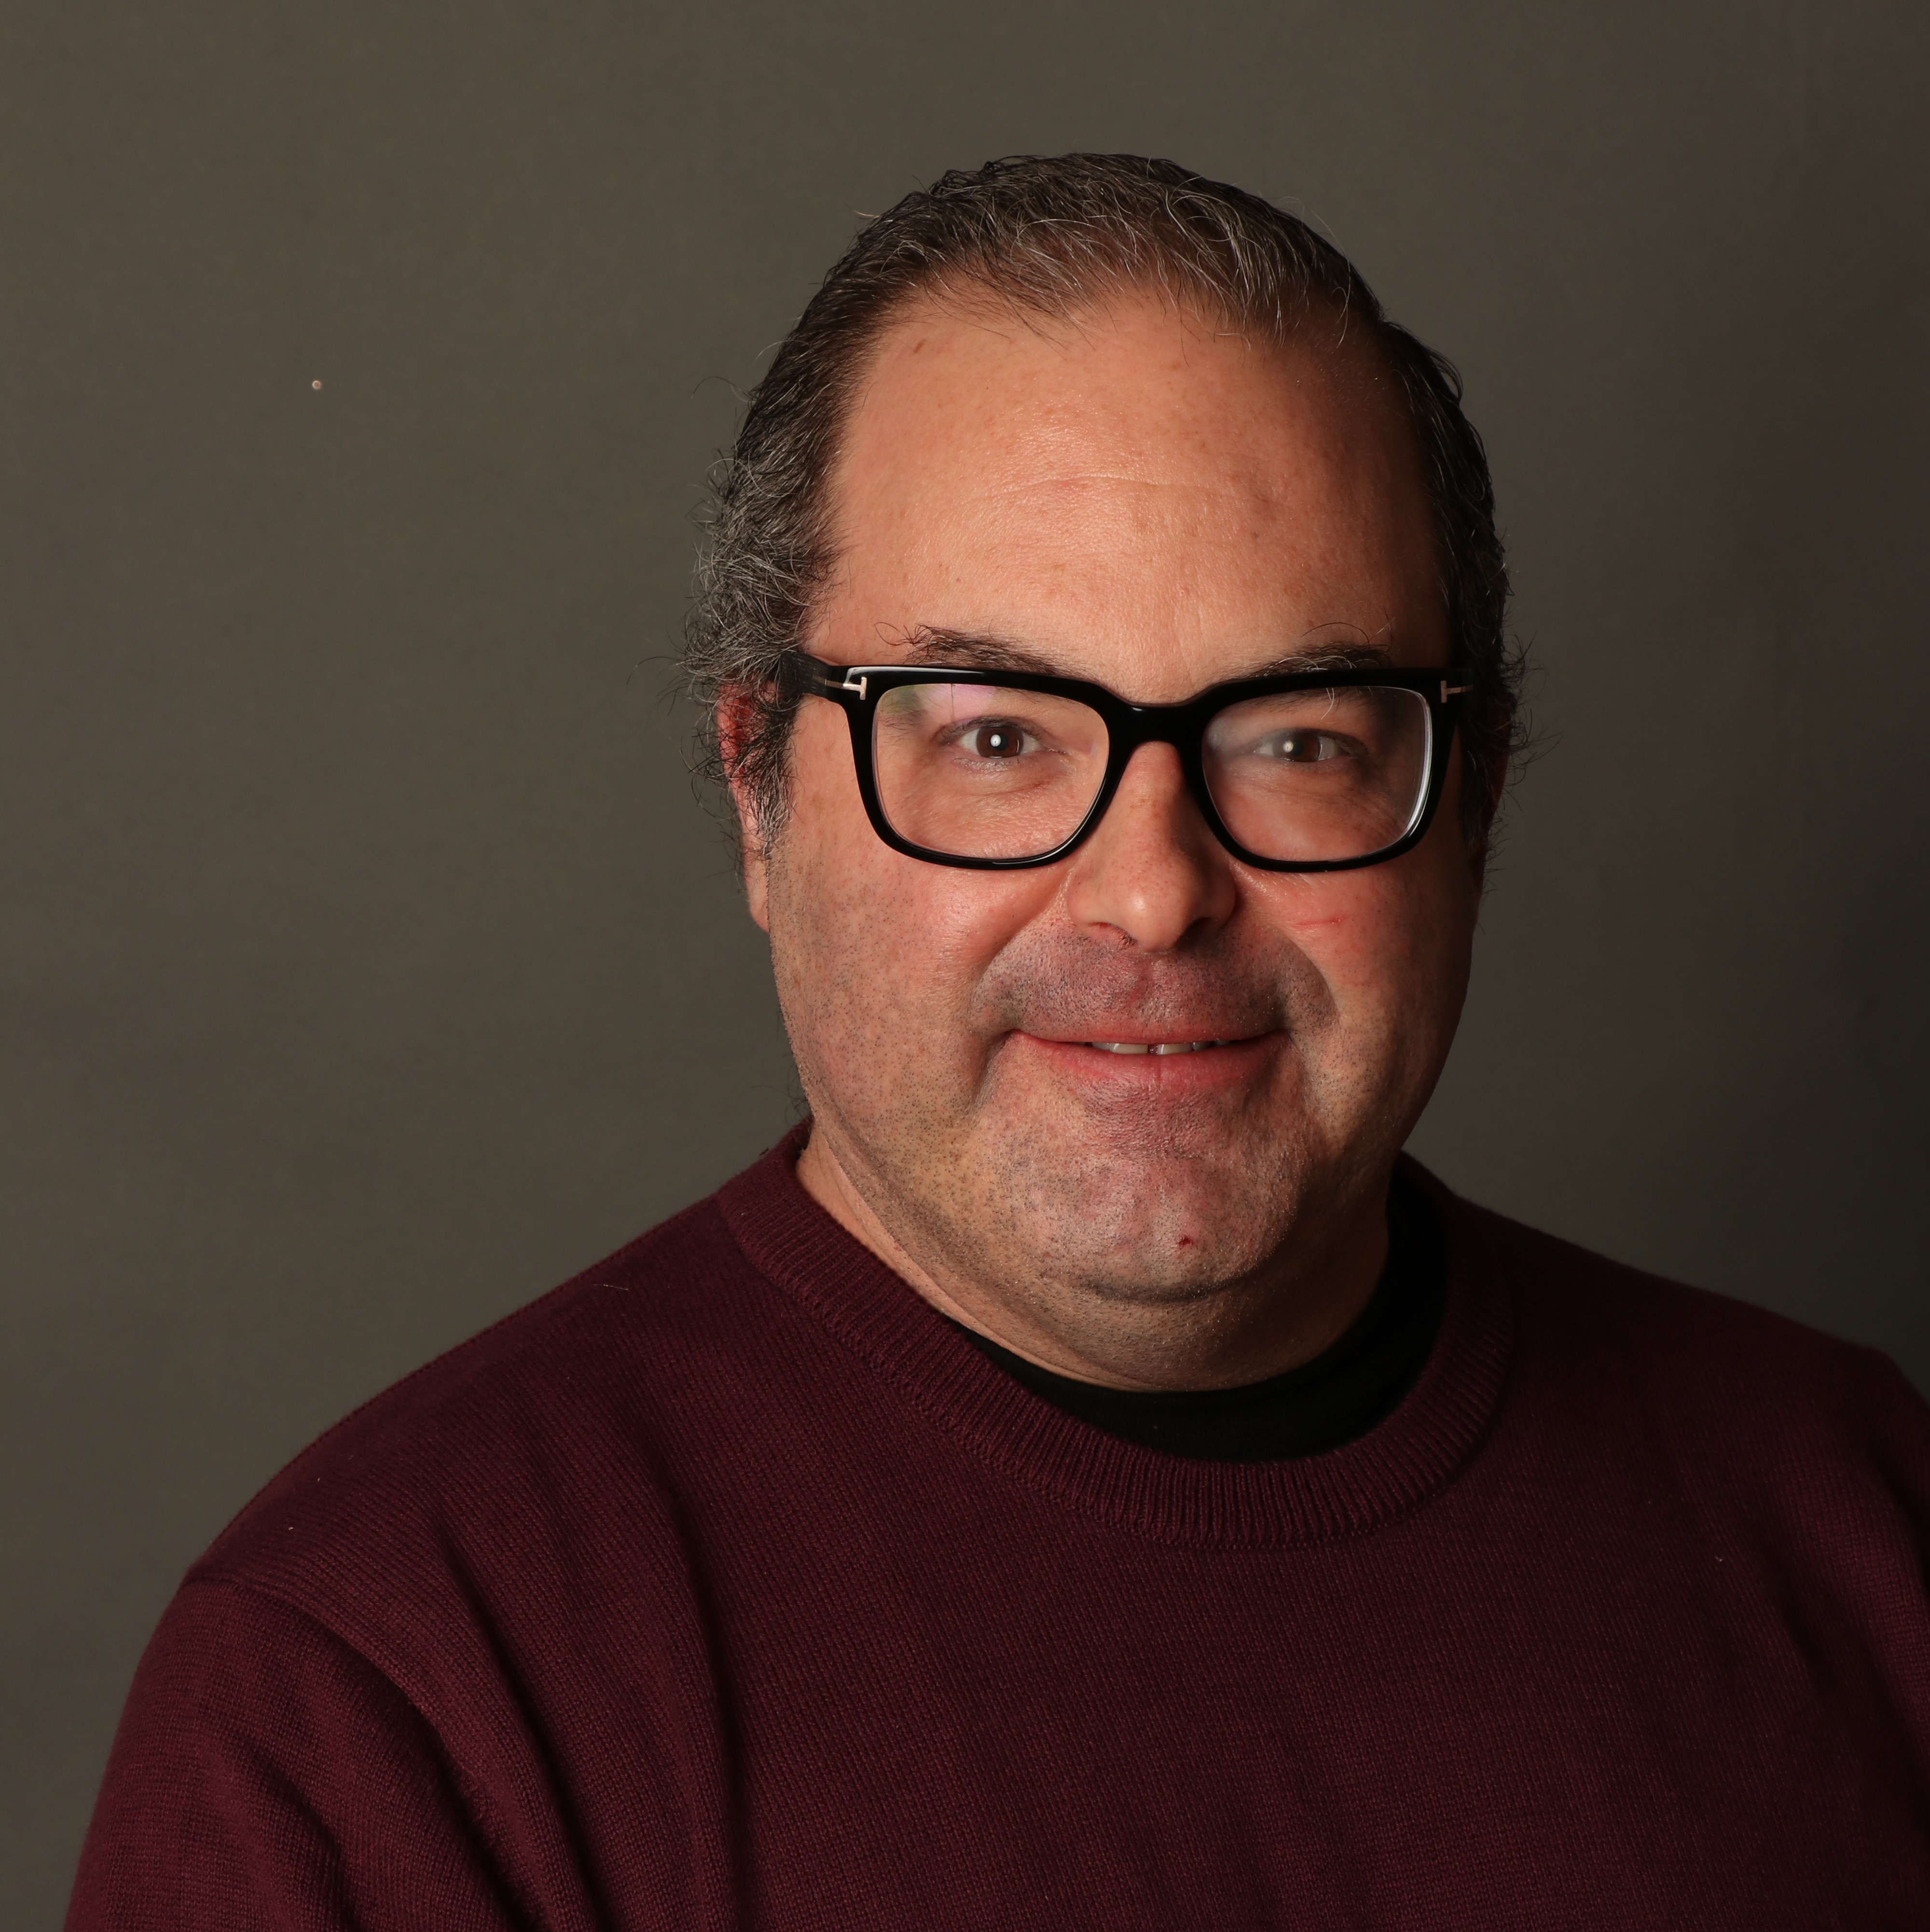


GitHub Copilot for Developers
Tim Warner
Principal Author, Pluralsight
timw.info | azureopenai.blog

Slide 2
Session Materials
timw.info/copilot-dev

Slide 3
Break Schedule (Central time)
09:00 AM - Start – Segment 1
10:00 AM - Break (8 min) – Segment 2
11:00 AM - Break (8 min) – Segment 3
12:00 PM - Break 3 (8 min) – Segment 4
01:00 PM - Finish

Slide 4
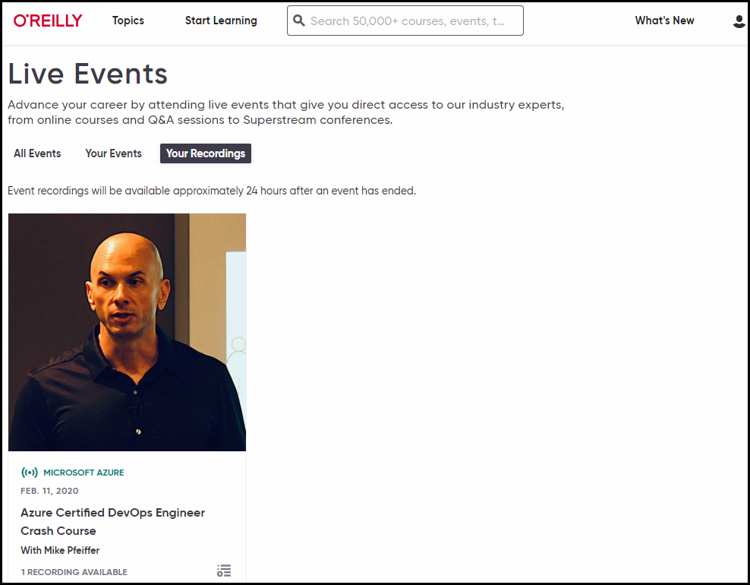
Session Recording

Slide 5
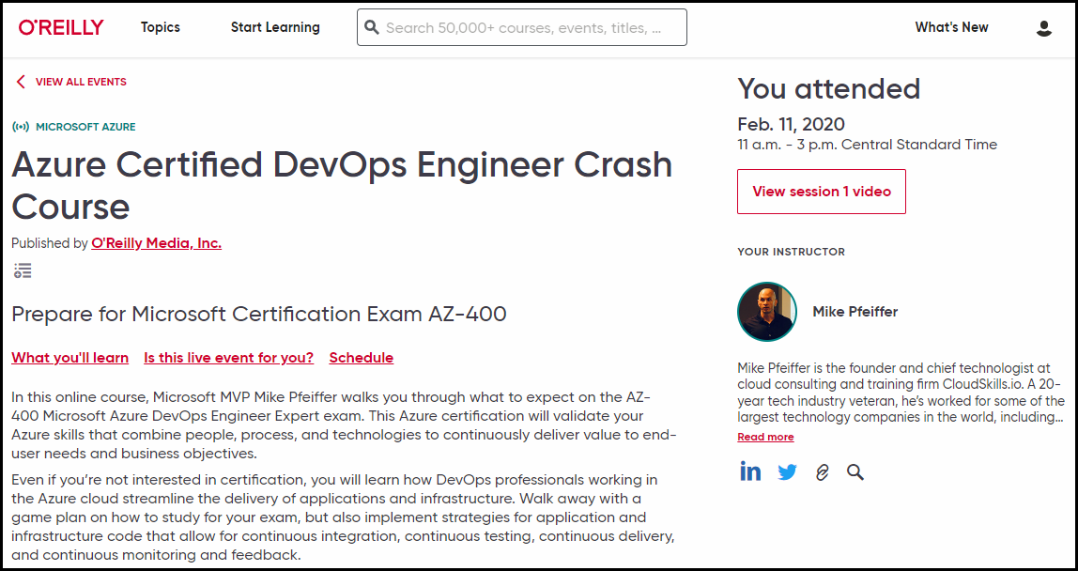
Session Recording

Slide 6


learning.oreilly.com

Slide 7



O'Reilly Native Mobile Apps

Slide 8
Let’s Get to Work!

Slide 9
Thanks!
Session materials: timw.info/copilot-dev
Web: techtrainertim.com
Summary

